Slide 1

Content: aka.ms/mkedevdays
#Azuredevdays

Slide 2
What is the right size of
servers for my business needs?
How do I deploy new code to my server?
What media should I
use to keep backup?
What happens in case of
server hardware failure?
Which packages should be on my server?
What size of servers
should I buy?
Who monitors
my App?
How often should I backup my server?
How can I scale my app?
How can I increase server utilization?
Who has physical
access to my servers?
Which OS should I use?
Do I need secondary network connection?
Are my server in a
secure location?
What happens if the
power goes out?
Who monitors
my Servers?
Do I need a UPS?
What storage I need to use?
How many servers
do I need?
How can I dynamically configure my app?
It takes how long to provision a new server?
How often should
I patch my servers?
On-Premises
The “evolution” of application platforms
Notes:
All good things begin with a story.
So before I talk to you about serverless, I wanted to discuss some history of how apps have been built through the years and how that has led us to the computing options we have today.
Buy your own hardware and software
Run it in your own data-centers
Deal with a multitude of questions
# of servers
Physical security
Hardware failure
Software patching
Backup
Essentially a lot of questions, not all of which might be directly related to running your business. For example, if you are running an insurance company, you want to spend your time growing and innovating in the insurance domain, not worrying about how to handle servers.

Slide 3
What is the right size of servers for my business needs?
How can I increase server utilization?
How many servers do I need?
How can I scale my app?
How often should I patch my servers?
How often should I backup my server?
Which packages should be on my server?
How do I deploy new code to my server?
Which OS should I use?
Who monitors my App?
On-Premises
IaaS
The “evolution” of application platforms
Notes:
Along came the cloud, and provided some relief from some of those questions.
IaaS in the cloud, allowed you to forget about managing all that physical hardware. Instead of hosting it yourself, you could now utilize servers hosted by someone else. While the worries around managing physical infrastructure are gone, there are a number of questions that still need to thought about:
How many virtual machines do I need?
How many would I need in future when my usage grows?
How to handle updating the servers for the latest security patches
How to think about deploying my code and the various dependencies, such as application runtimes, to the server
Who monitors my apps and so on
This means that you still haven’t reached that ideal state where you could focus purely on your business and its problems.

Slide 4
What is the right size of “servers” for my business needs?
How can I increase “server” utilization?
How many “servers” do I need?
How can I scale my app?
On-Premises
IaaS
PaaS
The “evolution” of application platforms
Notes:
Well, the cloud continue to help with that problem and with the advent of PaaS, there was even more simplification. PaaS allows you to just worry about your app, and let the cloud vendor take care of not only the physical hardware, but also the ongoing management of the operating environment like Operating Systems, Virtual Machines or Containers, as well as the various application runtimes, whether it is Java Runtime, .NET, Node.js, and so on.
You are not completely free from thinking about servers however, since you still have to worry about how to scale your app and accordingly specify the number and size of the various compute resources your apps would need at various times.

Slide 5
How do I architect my app?
Serverless, the platform for next gen apps
On-Premises
IaaS
PaaS
Serverless
The “evolution” of application platforms
Notes:
The latest in this series of evolution is Serverless – which further abstracts the underlying infrastructure from you, and allows you to focus only on a single question – how are you going to build your app to achieve the best results for your business, or whatever it is that you are trying to do with your apps.
Whether it is the code to delight your customers through a great experience, or the logic to communicate securely with a business partner, that is where most organization want to spend their creative energies on.
And serverless allows you to do just that, focus on your code and forget about the infrastructure.
This is why we believe it is the platform for next generation of apps.

Slide 6
What is serverless?

Slide 7
I need to run this CODE when this EVENT happens…

Slide 8
Serverless: Focus on code, not plumbing
Abstraction of servers
Event-driven scale
Sub-second billing
Notes:
Abstraction of servers, infrastructure and configuration of operating system
Event-driven scale
Sub-second billing
Stateless

Slide 9
Scenarios for Serverless
Anything that needs to respond to events
Real-time stream processing
Timer-based processing
Millions of devices feed into Stream Analytics
Transform to structured data
Store data in SQL DB
Every 15 minutes
Find and clean invalid data
Clean table
Backends (Mobile/IoT/Web)
Real-time bot messaging
?
...
Photo taken and WebHook called
Stores in blob storage
Produces scaled images
Message sent to Chatbot
Chatbot sends
response
Cortana Analytics answers questions
Notes:
So what kind of apps and scenarios can be built using serverless technologies? Anything where there is need to run some code or logic in response to an event. You will notice that this is a very broad definition and covers a vast array of scenarios.
Serverless application architectures
Event Grid connects data sources and event handlers. For example, use Event Grid to instantly trigger a serverless function to run image analysis each time a new photo is added to a blob storage container.
Ops automation
Event Grid allows you to speed automation and simplify policy enforcement. For example, Event Grid can notify Azure Automation when a virtual machine is created, or a SQL Database is spun up. These events can be used to automatically check that service configurations are compliant, put metadata into operations tools, tag virtual machines, or file work items.
Application integration
Event Grid connects your app with other services. For example, create an application topic to send your app’s event data to Event Grid and take advantage of its reliable delivery, advanced routing, and direct integration with Azure. Alternatively, you can use Event Grid with Logic Apps to process data anywhere, without writing code.

Slide 10

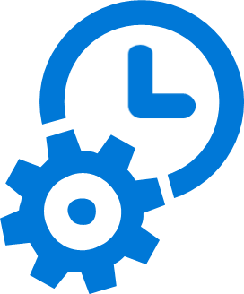
What are the benefits?
Solve business problems—not technology problems related to undifferentiated heavy lifting
Focus
Shorter time to market
Fixed costs converted to variable costs
Better service stability
Better development and testing management
Less waste
Efficiency
Simplified starting experience
Easier pivoting means more flexibility
Easier experimentation
Scale at your pace—don’t bet the farm on Day 1
Natural fit for microservices
Flexibility

Slide 11




Web application backends
Retail
Scenario Example: Retail
Online orders are picked up from a queue, processed and the resulting data is stored in a database
Request made in a web app
Request queued in Service Bus
A function processes the request…
..sends output to Cosmos DB
Notes:
Building backends for web applications. An example could be a web app adding incoming orders to a queue and then Functions automatically picking up those orders to process and adding the output to a Cosmos DB.

Slide 12


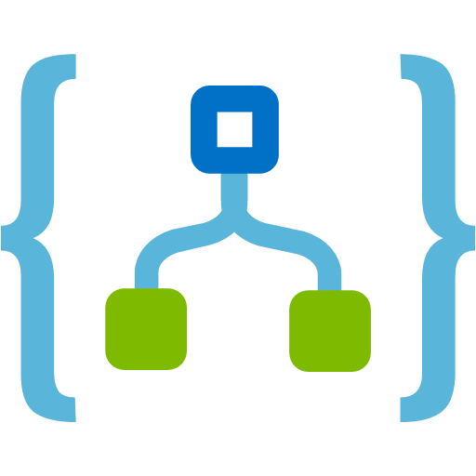
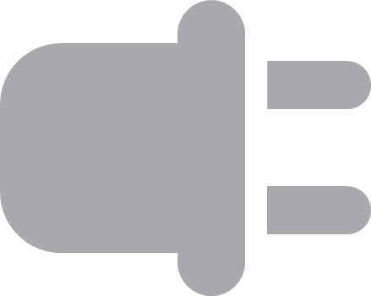

IoT-connected backends
Scenario Example: Manufacturing
A manufacturing company uses IoT to monitor its machines. Functions detects anomalous data and triggers a message to Service department when repair is required.
Connected IoT devices producing data
Scenario Example
Financial Services
Colleagues use mobile banking to reimburse each other for lunch: the person who paid for lunch requests payment through his mobile app, triggering a notification on his colleagues’ phones.
Data sent to IoT Hub
Data with special condition routed to a function
A function processes message...
…and calls Logic Apps
..which invokes Zendesk…
…to request device repair
Notes:
IoT is an important workload for serverless because of inherently spiky workloads associated with IoT. Processing huge amount of incoming data and doing some processing on that data in real time is a common serverless scenario

Slide 13


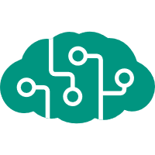

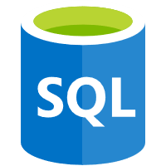

Real-time file processing
Scenario Example: Healthcare
Patient records are securely uploaded as PDF files. That data is then decomposed, processed using OCR detection, and added to a database for easy queries.
Scenario Example
Financial Services
Colleagues use mobile banking to reimburse each other for lunch: the person who paid for lunch requests payment through his mobile app, triggering a notification on his colleagues’ phones.
PDF file added to Blob Storage
A function decomposes PDF file…
…and sends it to Cognitive Services for OCR detection
Structured data from file sent to SQL DB
Notes:
Data transofrmation in real-time for use between different applications is a common scenario.

Slide 14


Real-time stream processing
Scenario Example: ISV
Huge amounts of telemetry data is collected from a massive cloud app. That data is processed in near real-time and stored in a DB for use in an analytics dashboard.
App or device producing data
Scenario Example
Financial Services
Colleagues use mobile banking to reimburse each other for lunch: the person who paid for lunch requests payment through his mobile app, triggering a notification on his colleagues’ phones.
Event Hubs ingests telemetry data
A function processes the data…
…and sends it to Cosmos DB
Data used for dashboard visualizations
Notes:
Processing streaming data for Big Data scenarios

Slide 15

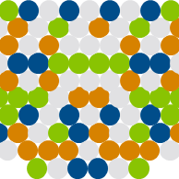
Automation of scheduled tasks
Scenario Example: Financial Services
A customer database is analyzed for duplicate entries every 15 minutes, to avoid multiple communications being sent out to same customers.
Scenario Example
Financial Services
Colleagues use mobile banking to reimburse each other for lunch: the person who paid for lunch requests payment through his mobile app, triggering a notification on his colleagues’ phones.
A function cleans a database every 15 minutes…
…deduplicating entries based on business logic
Notes:
Automating tasks that need to happen at regular intervals can be easily achieved using Functions. Whether it is for infra ops scenarios or just application architecture maintenance, Functions are a good fit.

Slide 16




Extending SaaS Applications
Scenario Example: Professional Services
A SaaS solution provides extensibility through webhooks, which can be implemented through Functions, to automate certain workflows
Scenario Example
Financial Services
Colleagues use mobile banking to reimburse each other for lunch: the person who paid for lunch requests payment through his mobile app, triggering a notification on his colleagues’ phones.
Issue created in GitHub…
…which triggers a webhook call
…which is processed by a function…
…by posting the issue details to Slack
Notes:
Azure Functions provides a very natural way of responding to webhook requests which makes it an excellent choice for extending any SaaS applications providing webhook extensibility.

Slide 17
Azure Functions

Slide 18



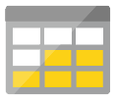


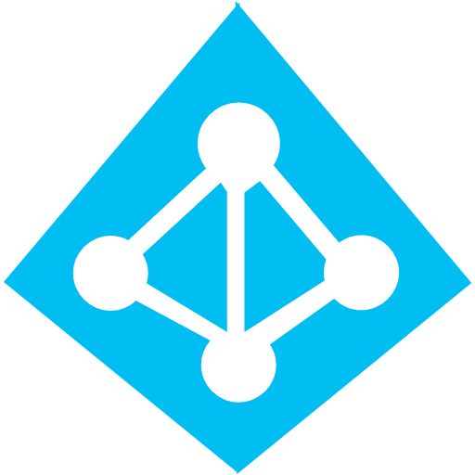

Azure serverless application platform
Development
Platform
IDE support
Functions
Event Grid
Logic Apps
Integrated DevOps
Execute your code based on events you specify
Manage all events that can trigger code or logic
Design workflows and orchestrate processes
Local development
Monitoring
Visual debug history
Database
Storage
Analytics
Intelligence
Security
IoT
Automation
Notes:
We provide not just a single service but a full platform that you can use to construct cloud native applications. At the core are three main services:
- Functions: Event-driven serverless compute experience
- Event Grid: Intelligent event routing service that bring both 1st party and 3rd party events to serverless compute to act upon.
- Logic Apps: Ability to create workflows and orchestrate processes in a rich designer experience.
Along side these core services, we provide a host of other managed building block services – like Database (Cosmos DB), Storage, Cognitive Services, IoT services etc. These services can be utilized by developers to build fully serverless applications which don’t require any infrastructure management

Slide 19



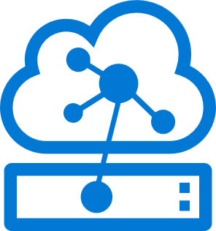
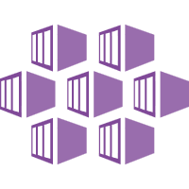

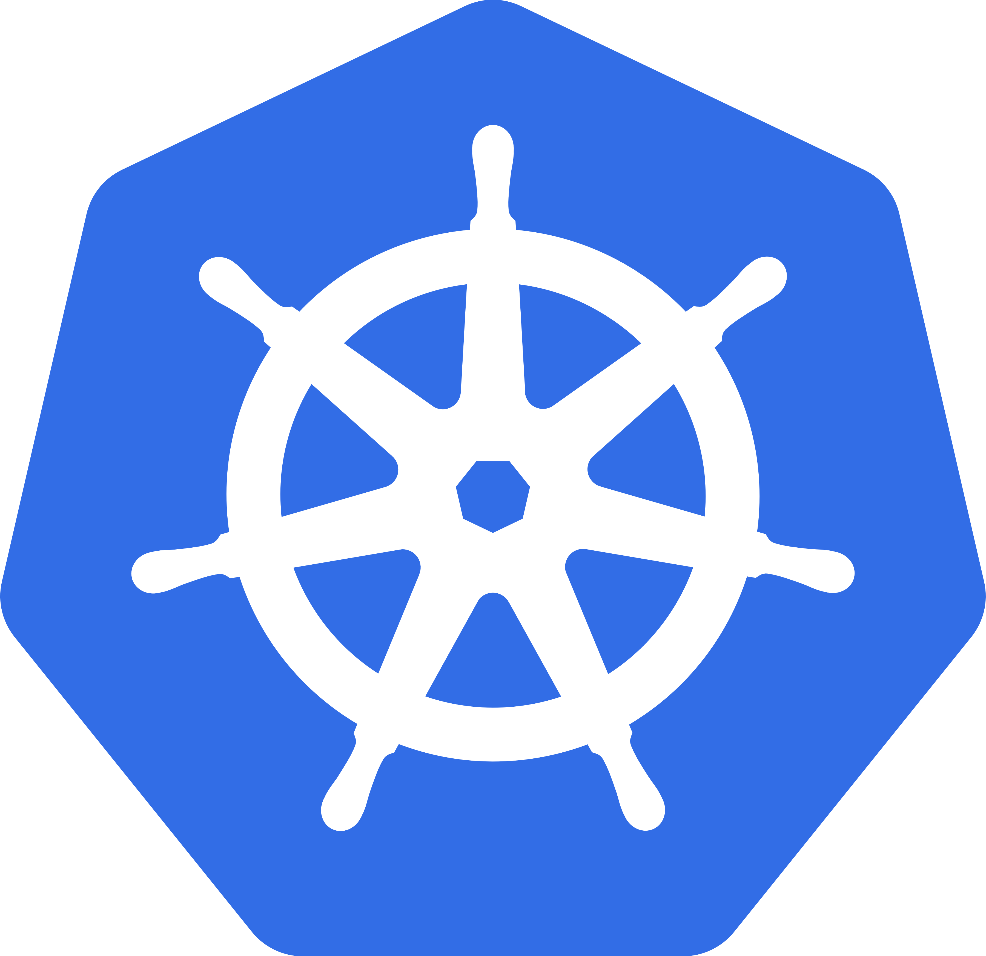
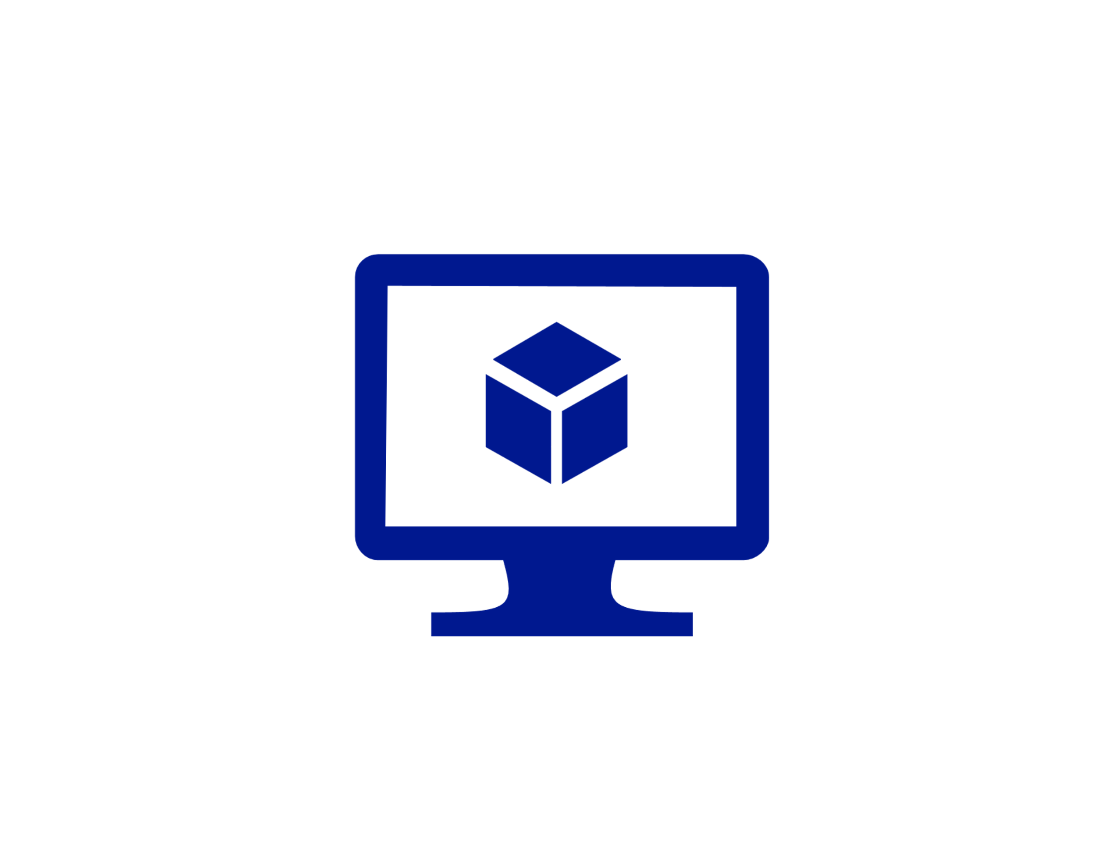
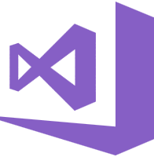
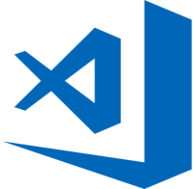
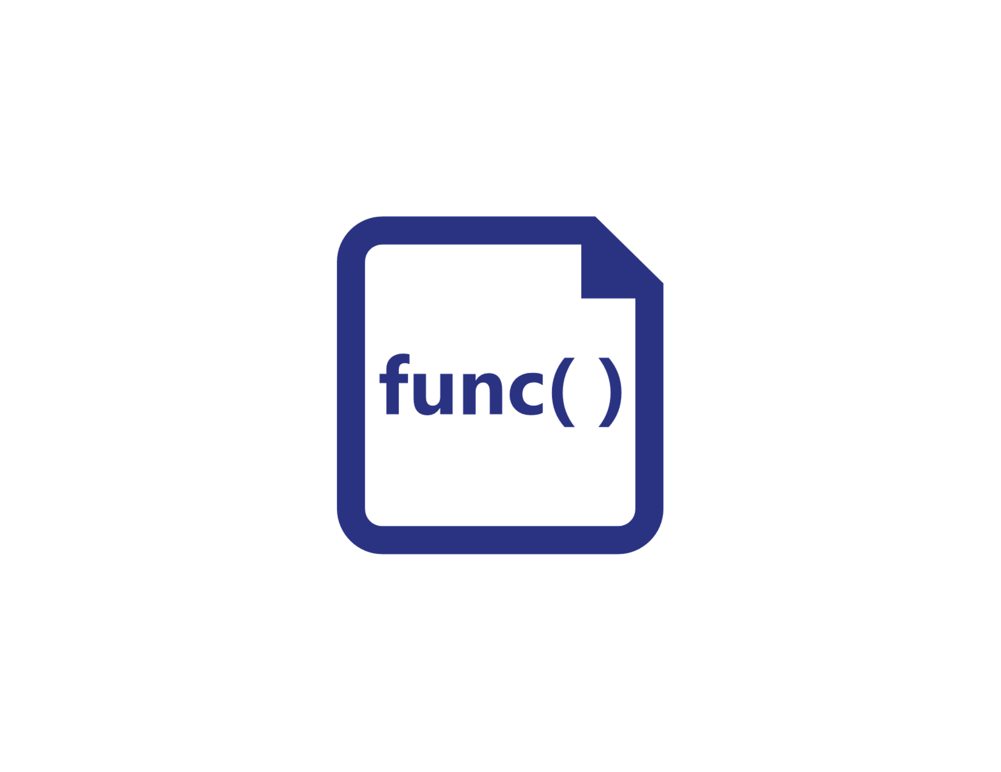
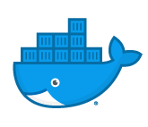
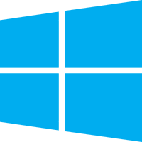


Functions everywhere
https://github.com/azure/azure-functions-host
(+other repos)
Azure Functions host runtime
Azure Functions Core Tools
Azure Functions base Docker image
Azure Functions .NET Docker image
Azure Functions Node Docker image
●●●
Development
Hosting
Local dev machine
Azure Functions
service
Azure Functions service
IoT devices
Additional Azure hosts
Non-Azure hosts
On-premises
Platform
+
●●●
●●●
●●●
Core Tools + favorite editor
Consumption plan
App Service plan
Azure IoT Edge
AKS, Service Fabric Mesh, …
K8s, raw VMs, & more
App Service on Azure Stack
Application delivery
Code or container
Code
Code or container
Container
Container
Container
Code
Operating system
Windows, macOS, or Linux
Windows or Linux
Windows or Linux
Linux
Linux
Linux
Windows

Slide 20

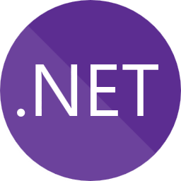

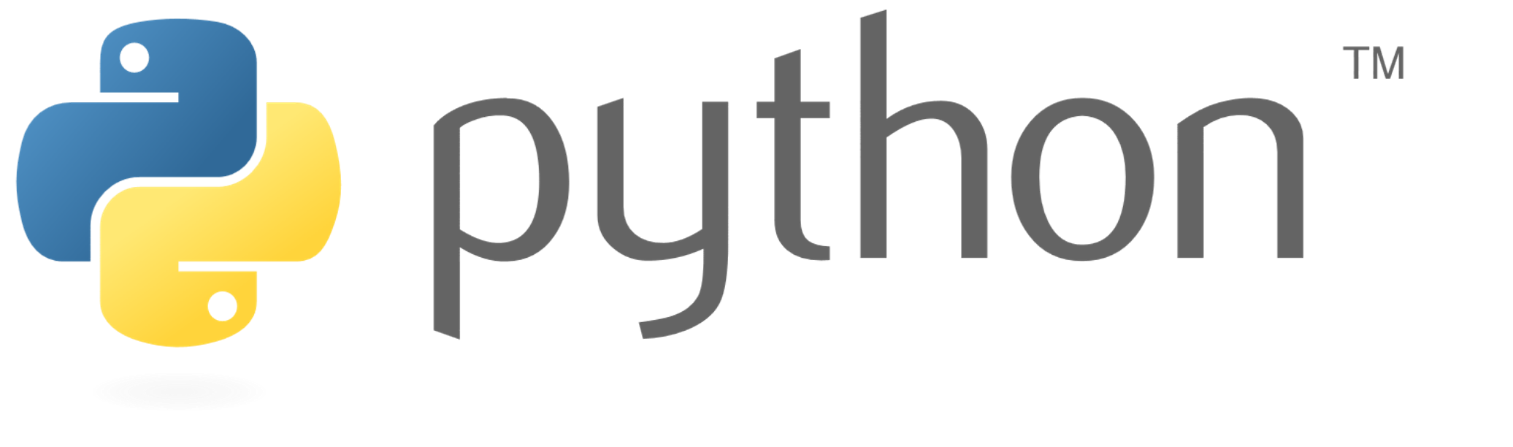
Language options
Generally available
Public preview
Private preview
New!
More on the way!

Slide 21
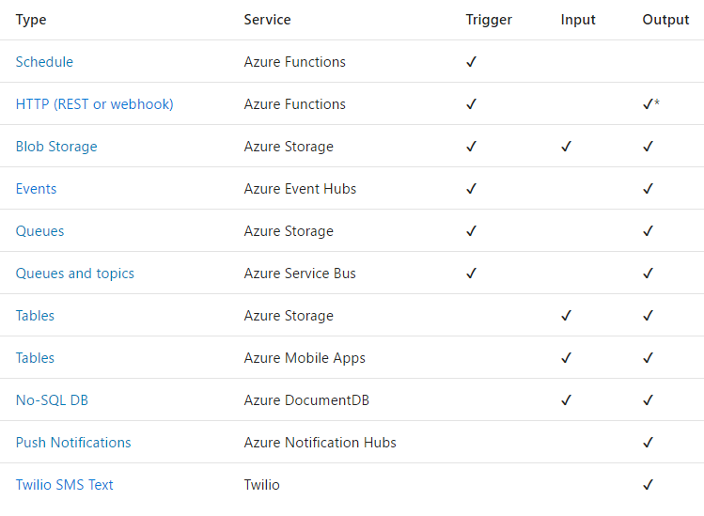
Triggers
and
Bindings

Slide 22
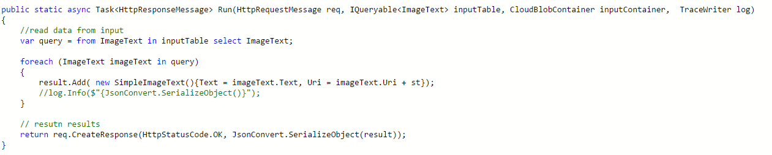
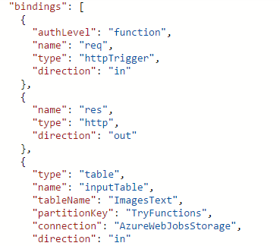
Functions Programming Model
Output
Trigger (data)
Input
Input
Input
Code
Output
Important: Functions have a single trigger
Functions can have multiple inputs and output bindings

Slide 23
Getting Started Demo
Create your Azure Function using Visual Studio
HTTP Trigger
Azure Queue Trigger
Notes:
Demo: Create your Azure Function using Visual Studio https://docs.microsoft.com/en-us/azure/azure-functions/functions-create-your-first-function-visual-studio

Slide 24
Output Bindings Demo
Create Azure Function using Azure Portal
HTTP Trigger Output Binding
Notes:
Demo: https://docs.microsoft.com/en-us/azure/logic-apps/quickstart-create-first-logic-app-workflow

Slide 25
FaaS is at the center of serverless Functions-as-a-Service programming model uses functions to achieve true serverless compute
Single responsibility
Functions are single-purposed, reusable pieces of code that process an input and return a result
Short lived
Functions don’t stick around when finished executing, freeing up resources for further executions
Stateless
Functions don’t hold any persistent state and don’t rely on the state of any other processes
Event driven & scalable
Functions respond to predefined events, and are instantly replicated as many times as needed

Slide 26

Azure Functions An event-based, serverless compute experience that accelerates app development
Azure Functions = FaaS++
Integrated programming model
Use built-in triggers and bindings to define when a function is invoked and to what data it connects
Enhanced development experience
Code, test and debug locally using your preferred editor or the easy-to-use web based interface including monitoring
Hosting options flexibility
Choose the deployment model that better fits your business needs without compromising development experience
Notes:
Building on top of the FaaS programming model, Azure Functions keep all the mentioned features and extend your possibilities with additional capabilities that help to reduce your development time and boost productivity, while using best in class tools.

Slide 27


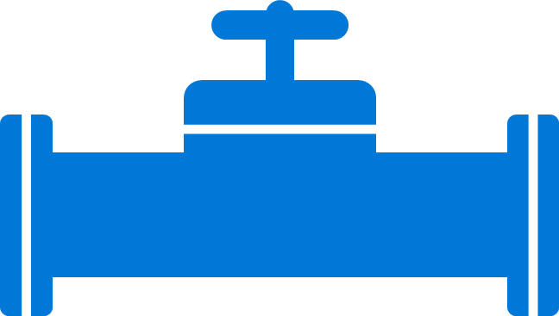
Boost development efficiency
Use triggers to define how functions are invoked
Avoid hardcoding with preconfigured JSON files
Build serverless APIs using HTTP triggers
Connect to data with input and output bindings
Bind to Azure solutions and third-party services
Use HTTP bindings in tandem with HTTP triggers
Triggers
Bindings
Define one API surface for multiple function apps
Create endpoints as reverse proxies to other APIs
Condition proxies to use variables
Debug C# and JavaScript functions locally
Use debugging tools in Azure portal, VS, and VS Code
Proxies
Local debugging
Save time with built-in DevOps
Deploy functions using App Service for CI
Leverage Microsoft, partner services for CD
Integrate with Azure Application Insights
Get near real-time details about function apps
See metrics around failures, executions, etc.
CI/CD
Monitoring
Notes:
Additional information
Triggers and bindings – https://docs.microsoft.com/en-us/azure/azure-functions/functions-triggers-bindings
Monitoring—https://azure.microsoft.com/en-us/services/application-insights/
Local debugging—https://docs.microsoft.com/en-us/azure/azure-functions/functions-run-local#run-functions-locally
CI/CD—https://docs.microsoft.com/en-us/azure/azure-functions/functions-continuous-deployment
Run locally—https://docs.microsoft.com/en-us/azure/azure-functions/functions-run-local
Proxies—https://docs.microsoft.com/en-us/azure/azure-functions/functions-proxies

Slide 28


Gain flexibility and develop your way
Write code in C#, JavaScript, F#, and Java
Continuous investment in new, experimental languages
Write stateful functions in a serverless environment
Simplify complex, stateful coordination problems
Add the extension to enable advanced scenarios
Multiple languages
Durable Functions
Choose from six consumption plans to run Functions
Run your first million function executions for free
Simplify coding for new users with native Azure portal
Select from popular editors, like VS, VS Code, CLI, Maven*
Hosting options
Dev options
*VS and VS Code only support C#; Maven only supports Java
Notes:
Additional information
Languages—https://docs.microsoft.com/en-us/azure/azure-functions/supported-languages
Dev options—
Azure Functions portal—https://docs.microsoft.com/en-us/azure/azure-functions/functions-create-first-azure-function
Visual Studio—https://docs.microsoft.com/en-us/azure/azure-functions/functions-develop-vs
Visual Studio Code—https://code.visualstudio.com/docs
CLI—https://docs.microsoft.com/en-us/azure/azure-functions/functions-create-first-azure-function-azure-cli
Java/Maven—https://docs.microsoft.com/en-us/azure/azure-functions/functions-create-first-java-maven
Hosting options—https://azure.microsoft.com/en-us/pricing/details/functions/
Durable Functions—https://docs.microsoft.com/en-us/azure/azure-functions/durable-functions-overview

Slide 29
SMS Sentiment Demo – Send SMS to 312-313-0075
Notes:
Demo: https://docs.microsoft.com/en-us/azure/logic-apps/quickstart-create-first-logic-app-workflow

Slide 30
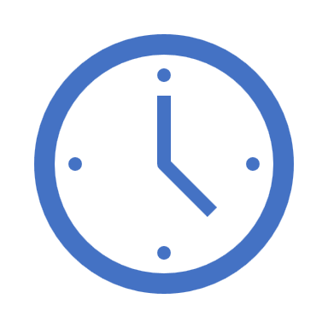

Durable Functions
var outputs = new List<string>();
outputs.Add(await context.CallActivityAsync<string>("SayHello", "BRK3348"));
return outputs;
History Table
Orchestrator Function
Activity Function
Orchestrator Function
Activity Function
Orchestrator Started
Execution Started
Task Scheduled, SayHello, "BRK3348"
Orchestrator Completed
["Hello BRK3348!"]
"Hello BRK3348!"
"Hello BRK3348!"
Task Completed, "Hello BRK3348!"
?
Orchestrator Started
Execution Completed, ["Hello BRK3348!"]
Orchestrator Completed
Execution History

Slide 31
Demo
Create a Durable Function
Notes:
Demo: https://docs.microsoft.com/en-us/azure/logic-apps/quickstart-create-first-logic-app-workflow

Slide 32
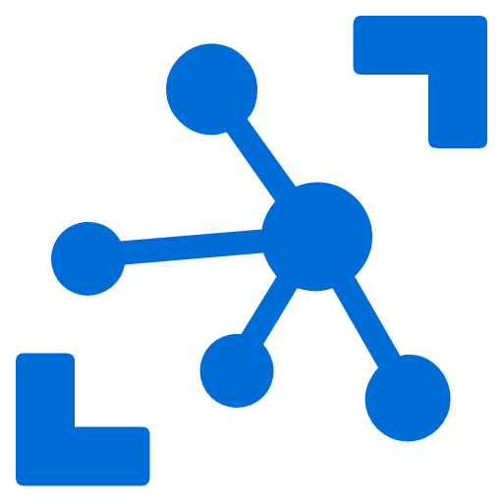


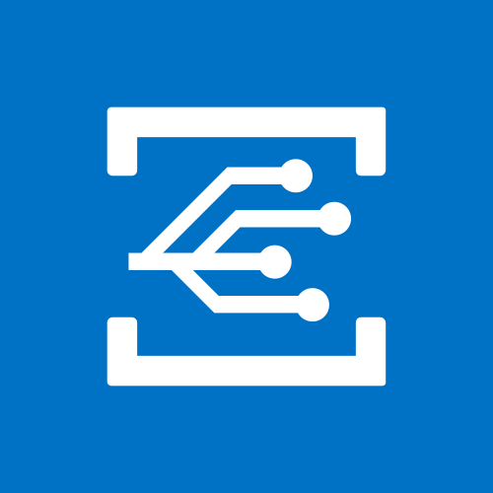
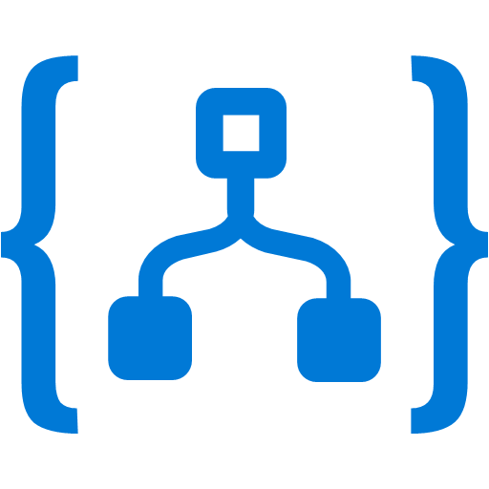
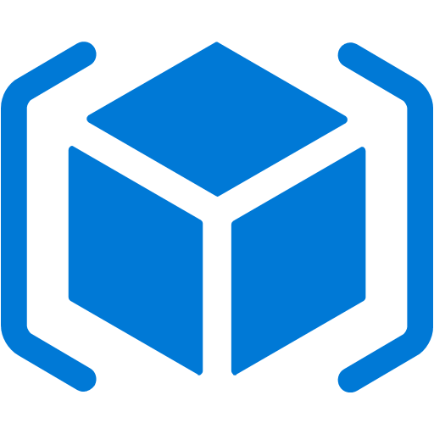

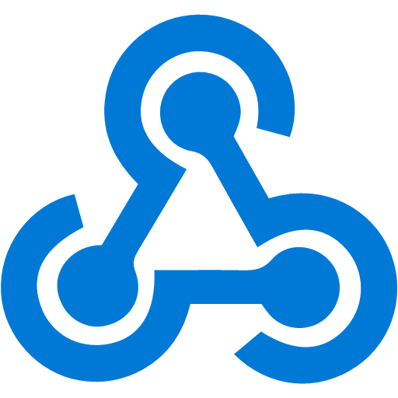

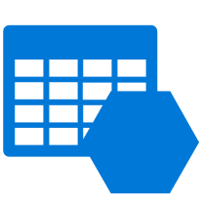
Event Grid
Event publishers
IoT Hub
Event handlers
Blob Storage
Azure Functions
Eliminate polling—and the associated cost and latency
Build reliable apps and services through reactive programming
Enable richer scenarios by connecting multiple event sources and destinations
Support for open CloudEvent standard
Azure Subscriptions
Logic Apps
Resource Groups
Azure Automation
Event Hubs
WebHooks
Custom Topics
Event Hubs
Storage (GPv2)
Notes:
Now, I would like to describe the capabilities of our core serverless services, in a little more detail, this time starting with Azure Event Grid.
We already talked about how important events are.
This service allows you to manage all events in a single place
Notice that multiple Azure services today publish their events into Event Grid and these events can be routed to multiple destination. We have Functions, Logic Apps and even other services like Automation and generic webhooks.
You can also create your own customer events
The rich set of publishers and consumers opens up many interesting scenarios for you to construct already. And the list of services that will publish their events to Event Grid will continue to grow over time.

Slide 33
Event Grid delivers at massive scale
Sub-second end-to-end latency in the 99th percentile
10,000,000 events per second per region
24-hour retry with exponential back off for events not delivered
Near real-time
Massive scale-out
High reliability
Notes:
In terms of performance and scale, Event Grid makes some strong guarantees.
Sub-second e2e latency in the 99th percentile, which is as close to real-time delivery as it gets
An ability to route about 10 million events per second, so massive scale
And, an intelligent logic to retry the event delivery if the first time doesn’t succeed
All of these make Event Grid a very powerful event backbone for your serverless applications.

Slide 34
Logic Apps

Slide 35

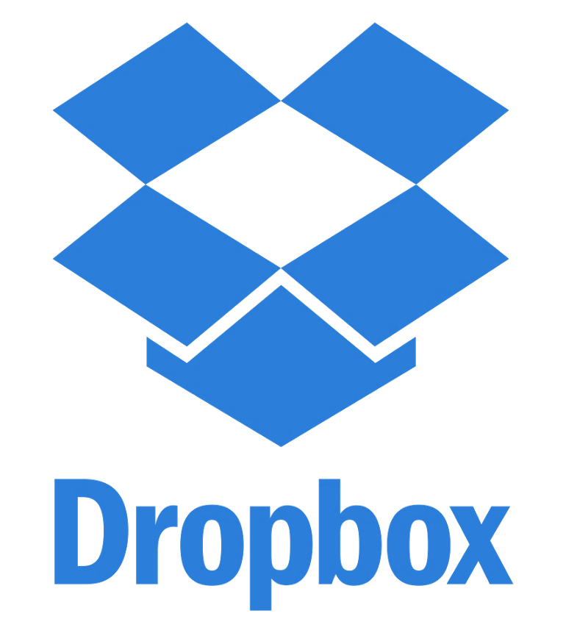

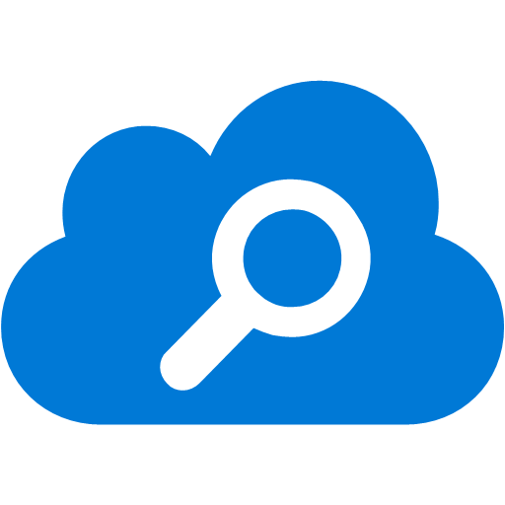

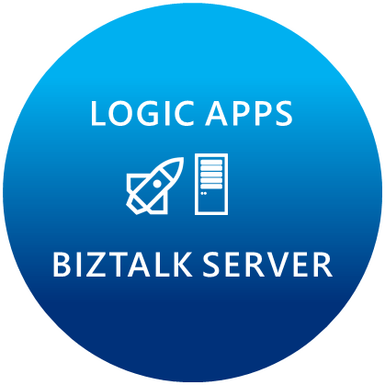
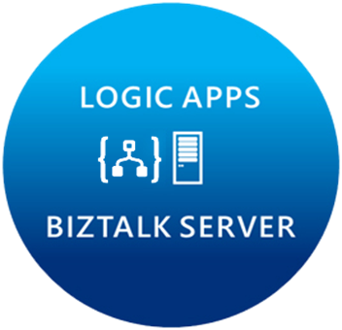
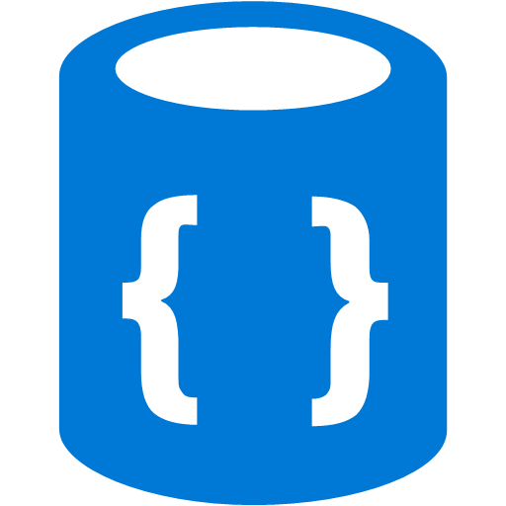
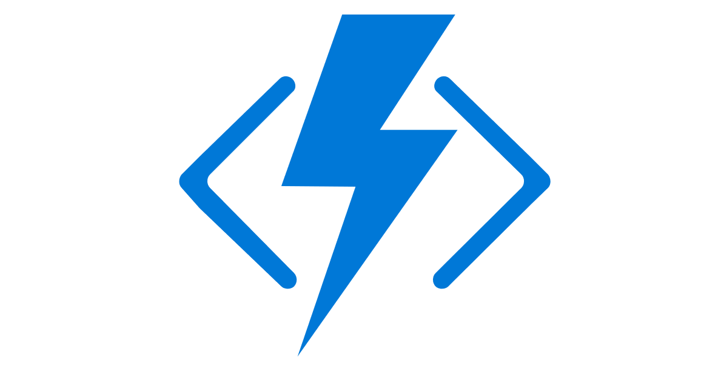


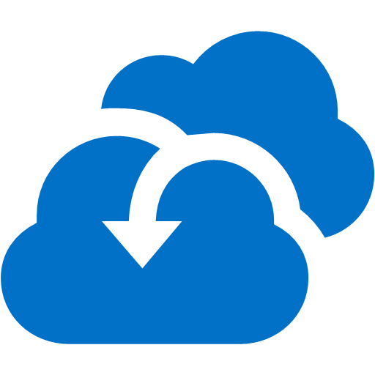

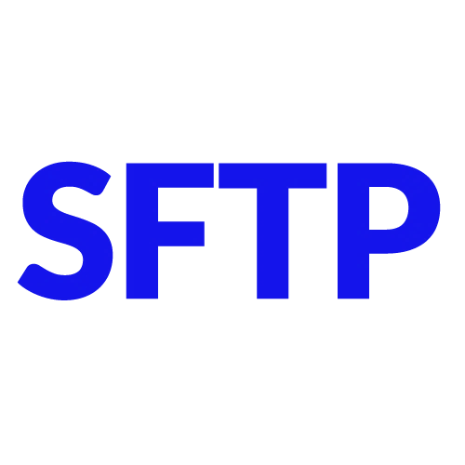

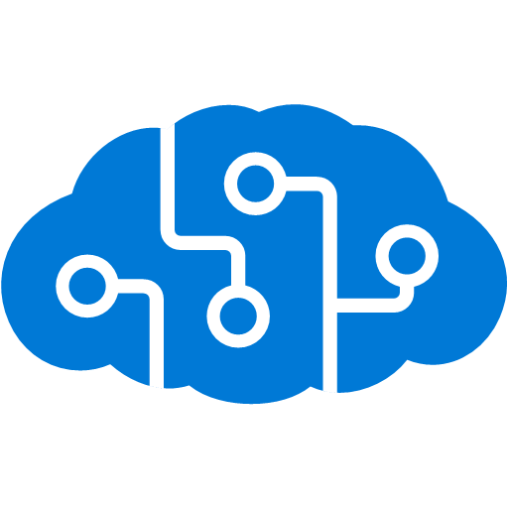


Microsoft’s Hybrid Integration Platform
LOGIC APPS
BIZTALK SERVER
About 39% of developers are focused on building cloud based Application integration
API MANAGEMENT
AZURE SERVICE BUS
IoT/Event Hub
Azure Search
SQL Database
CONNECTORS
AZURE SERVICES
AZURE SERVICE BUS
DocDB
BLOB Storage
Functions
API MANAGMENT
Machine Learning
HD Insight
Site Recovery
B2B/EDI
Tables
Cognitive Services
DNS

Slide 36
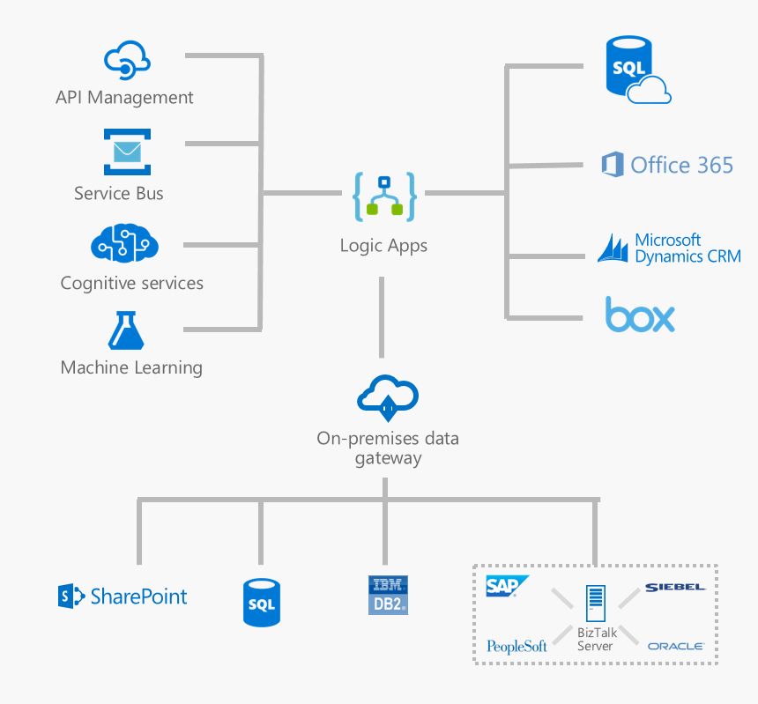
Microsoft's
Hybrid
Integration Platform
Connect on-premises, hybrid and cloud applications
Run mission-critical, complex integration scenarios with ease
Enhance business productivity by automating business processes where it makes sense, on-premises or in Azure
Build “Smart” Integrations leveraging Machine Learning/Cognitive Services

Slide 37
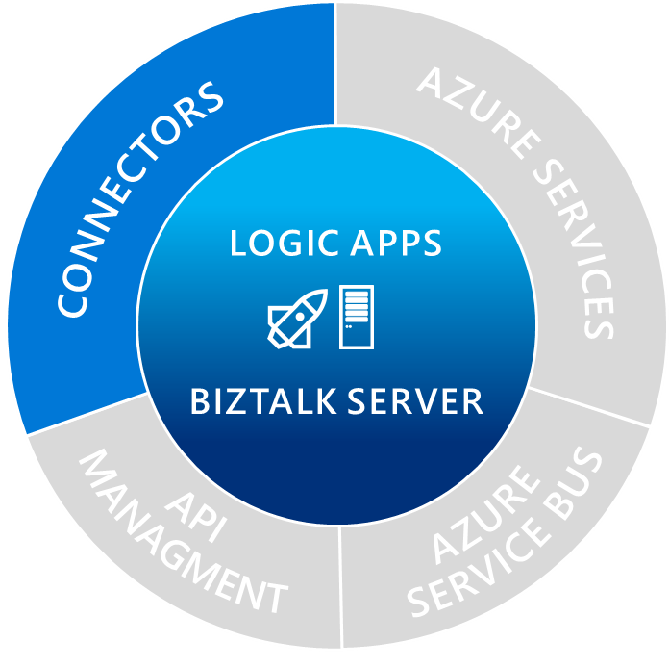
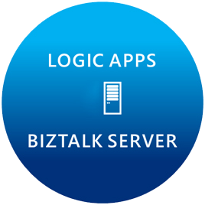

Spectrum of connectors
SaaS
appFigures
Asana
Azure API Management
Azure App Services
Azure Cognitive Face API
Azure Cognitive Text Analytics
Azure Document DB
Azure Functions
Azure Machine Learning
Azure Resource Manager
Azure Service Bus
Azure SQL
Azure Storage Blob
Azure Storage Queues
Basecamp
Bing Search
Bitly
Blogger
Box
Buffer
Campfire
Common Data Service
Disqus
DocuSign
Dropbox
Dynamics AX Online
Dynamics CRM Online
Dynamics CRM Service Bus
Dynamics Financials
Dynamics Operations
Easy Redmine
Facebook
Freshdesk
GitHub
Google Calendar
Google Drive
Google Sheets
Google Tasks
Harvest
JIRA
Insightly
Instagram
Instapaper
MailChimp
Mandrill
Medium
Microsoft Project Online
Microsoft Translator
MSN Weather
Office 365
Office 365 Users
Office 365 Video
OneDrive
OneDrive for Business
OneNote
Outlook.com
PagerDuty
Pinterest
Power BI
Project Online
Redmine
Salesforce
Salesforce Chatter
SendGrid
SharePoint Online
Slack
SmartSheet
SparkPost
Survey Monkey
Todoist
Trello
Twilio
Twitter
Typeform
VS Team Services
Wordpress
Wunderlist
Yammer
YouTube
Protocols/Native
XML & EDI
Hybrid
HTTP, HTTPS
HTTP Webhook
FTP, SFTP
SMTP
RSS
Compose, Query
Wait
Terminate
Workflow
XML Validation
Transform XML (+Mapper)
Flat File Encode
Flat File Decode
X12
EDIFACT
AS2
Integration Account Artifact Lookup
BizTalk Server
File System
IBM DB2
Informix
SharePoint Server
SQL Server
SAP
Websphere MQ

Slide 38
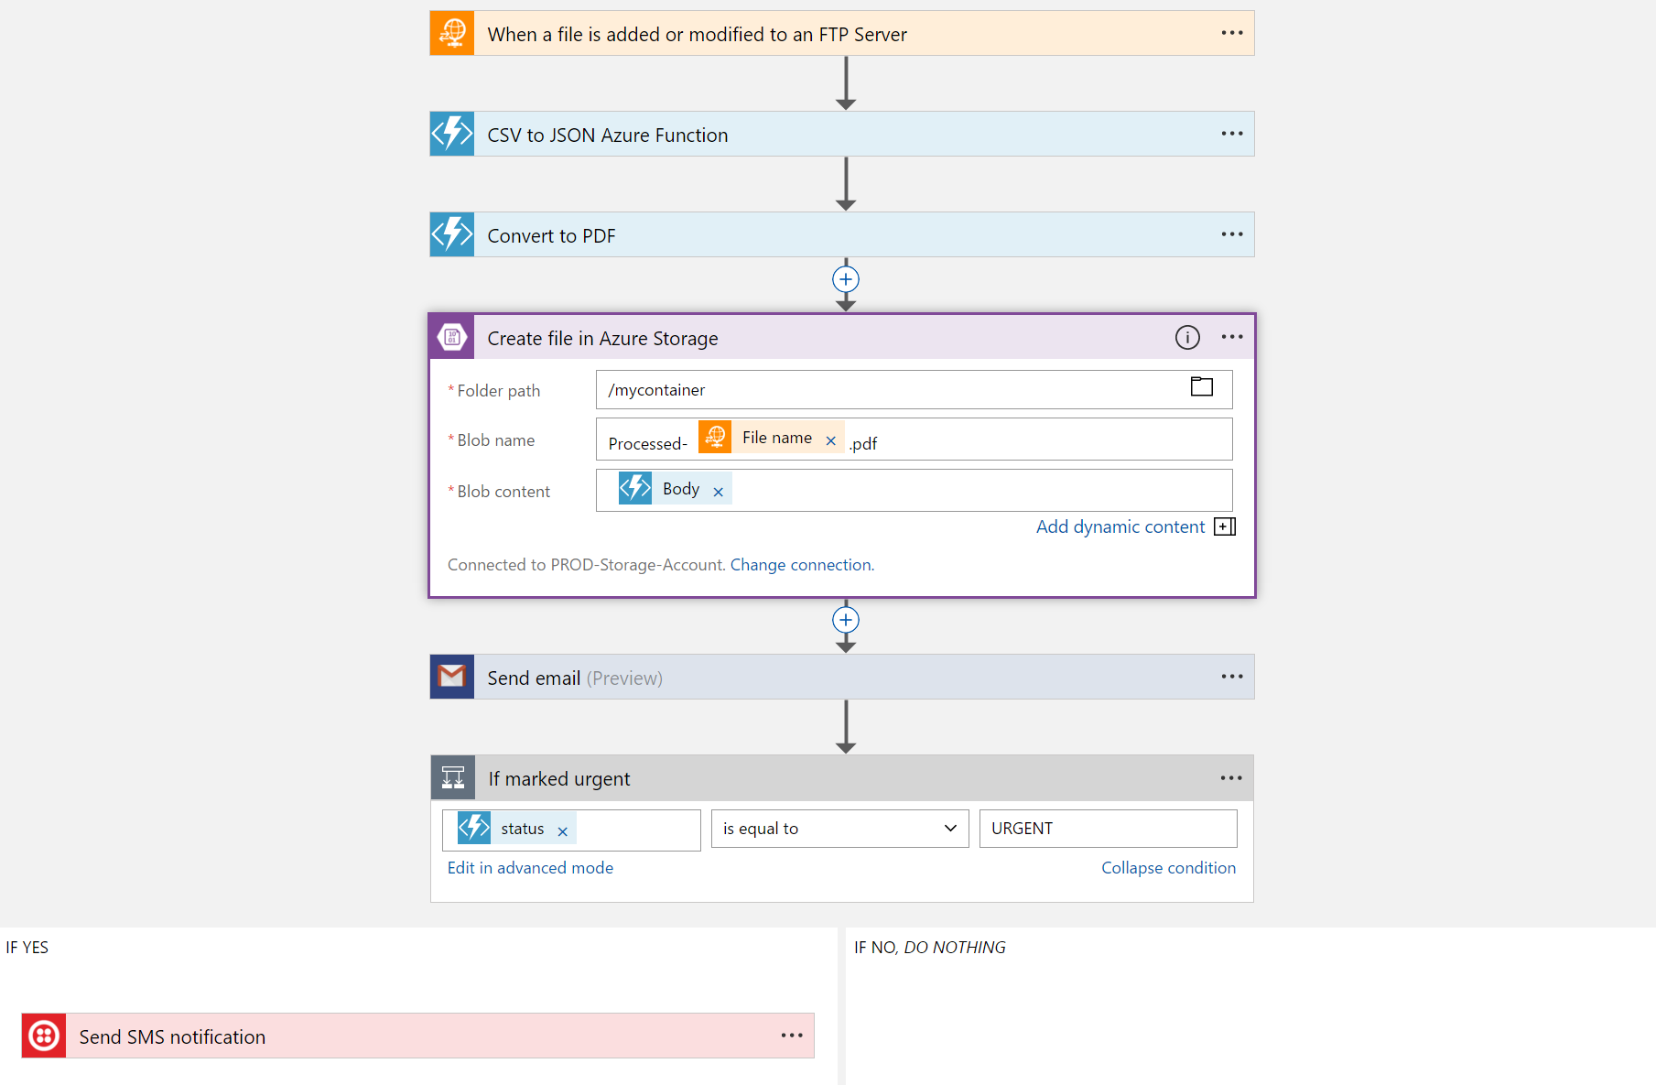
Logic Apps
Visually design workflows in the cloud
Express logic through powerful control flow
Connect disparate functions and APIs
Utilize declarative definition to work with CI/CD
Notes:
Moving on to Logic Apps
Logic Apps is a service that provides a visual design experience for creating serverless workflows in the cloud without writing any code.
No matter how complex your business logic is, you can express it using the powerful control flow available in Logic Apps.
Another key value of this service is that, it provides connections with multiple services and allows you to orchestrate all these services along with the functions which you or someone else in your organization might have written.
Lastly all of these workflows are internally represented using a declarative definition format, again making it very friendly with your existing CI/CD practices

Slide 39
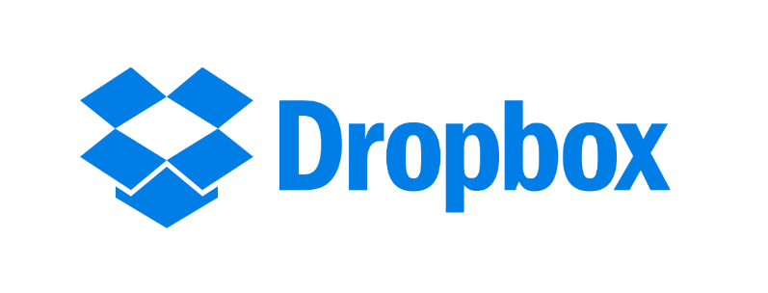

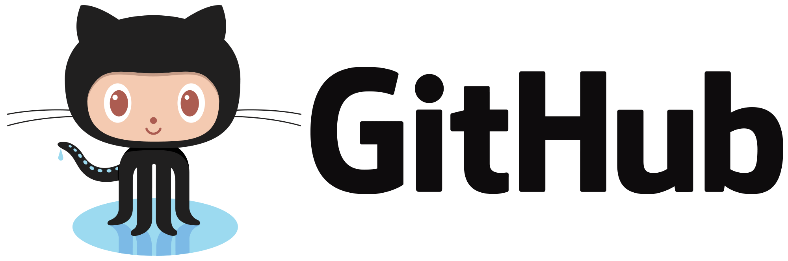
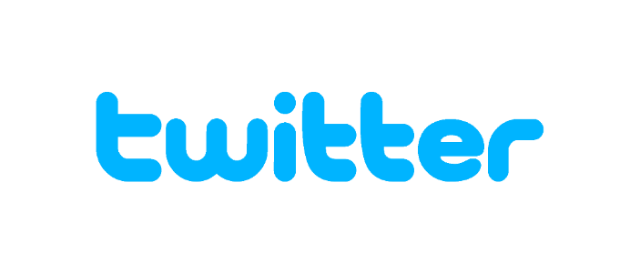


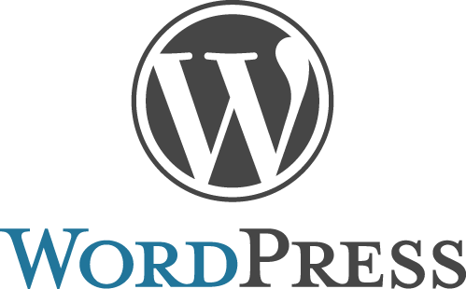
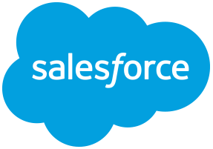

Logic Apps connectors—Over 200 and growing
….and more!
Notes:
Logic Apps support more than 170 connectors already. It goes without saying that it supports most Azure services but you can see from this list that it also supports many popular 3rd party services like Dropbox, Twitter, Salesforce and so on.
And it does that without requiring you to understand how any of these other services work. It completely abstracts the integration details of how to communicate with these other services and their specific API, SDKs and protocols.
And now to talk about the details of Azure Functions, let me call back the person who has been working on this thing before it was a thing. Chris.

Slide 40
Demo
Create Logic App using Azure Portal
Notes:
Demo: https://docs.microsoft.com/en-us/azure/logic-apps/quickstart-create-first-logic-app-workflow

Slide 41


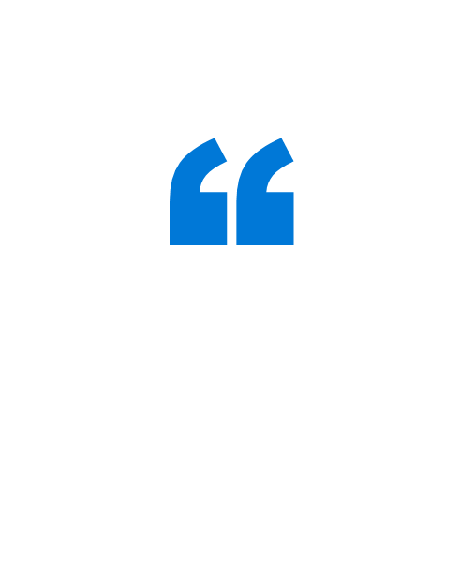
FUJIFILM Software, the software arm of the multinational photography and imaging company, started using Functions to develop its file management solution, called IMAGE WORKS, in separate service units. This, along with implementing microservices with Functions, boosted the solution’s stability and helped FUJIFILM cut development time for new functions by 75%.
A long development and build period can lead to missed business opportunities. So Azure deserves high praise for helping us get to a fully validated release in six months.
Daichi Hayata Design Leader Advanced Solutions Group, IMAGE WORKS Team FUJIFILM Software
Notes:
Case study source: https://customers.microsoft.com/en-us/story/fujifilm-software-co-ltd

Slide 42
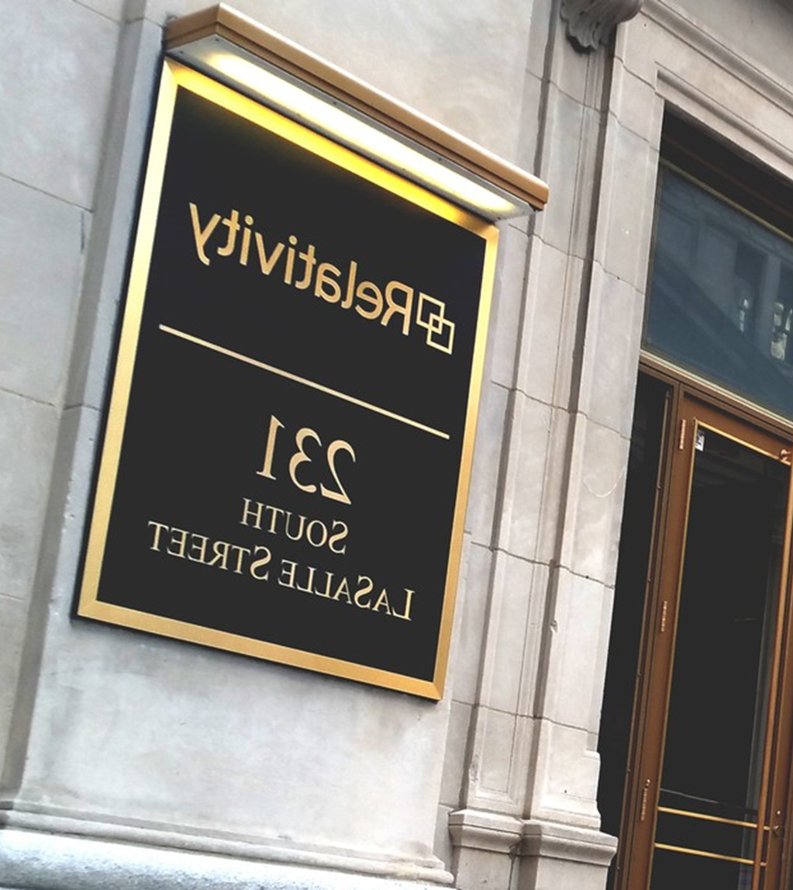

Relativity wanted to improve the customer experience of its RelativityOne cloud-based e-discovery platform. The company decided to create a monitoring solution based on a serverless architecture powered by Microsoft Azure Functions that proactively identifies and resolves performance issues. Now, some projects that used to require a few months, can be completed in a few days.
When we can develop a solution in a week using Azure Functions versus four months using traditional methods, that represents a drastic improvement in our ability to solve business-critical problems.
Hristo Papazov Senior Software Engineer Relativity
Notes:
Case study source: https://customers.microsoft.com/en-us/story/direct-one-professional-services-azure

Slide 43

Thank You
Please fill out survey

